Slide 1
My Happy Place 10 Reasons I Love Visual Studio Online
brosteins.com
@mikebranstein
@brosteins

Slide 2
House Keeping – I Need Volunteers
Notes:
2 types of volunteers – the first type is something where I need just one person – maybe a second if you have trouble counting
The second type is a group activity.

Slide 3
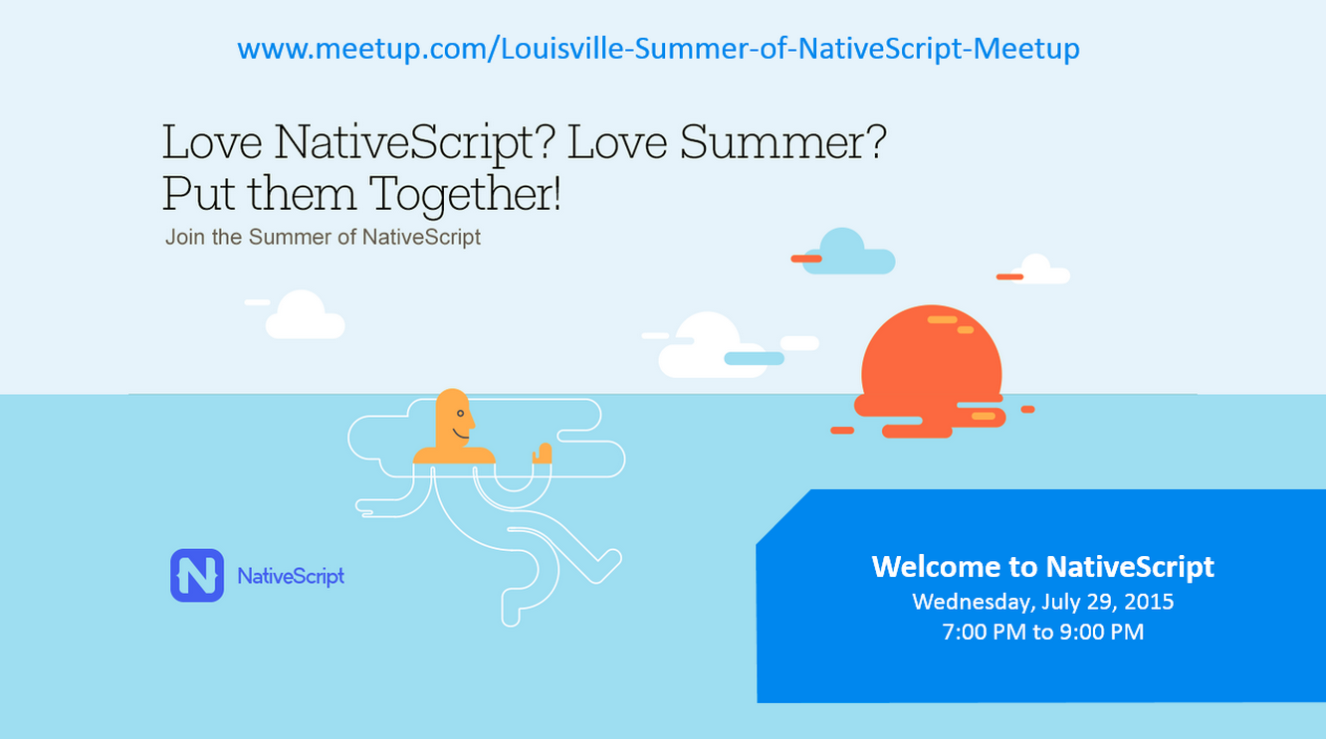
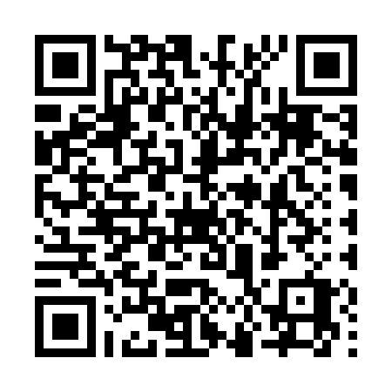

Slide 4


Notes:
The cloud is a magic place – it enables us to do anything and everything.
Tell a story about Ilse – she’s excited to be “in the cloud”. Telling her friends and neighbors she’s “in the cloud” now.
Share another secret with you – sometimes marketing has no idea how to talk to us / developers. And they name products stupid things.

Slide 5

Version Control
Team Collaboration
Testing
Requirements Management
Build Services
Notes:
What does this mean that things have changed? It means that VSO is a collection of services. Each interacting, but separately reving. .
Accounts and profiles
Build
Cloud Load Test
Git
Code Policy
Proejct and Teams
Servie Hooks
Team Rooms
Test Management
Version Control
Work
Work item tracking

Slide 6
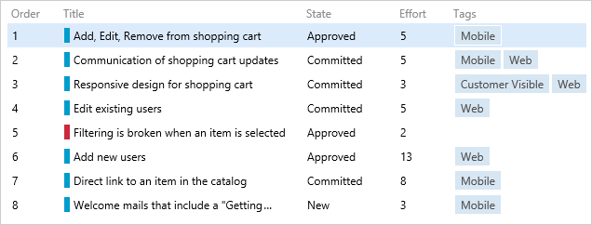
1. Backlog Management
Notes:
Work item tracking, backlog management, areas, iterations, epics, features, pbi – choice between agile, scrum, and cmmi process flows
Intent here is to show some really quick backlog management techniques
Add new item
Re-order
Track details about item (description, status, acceptance criteria, tag)
Link to a feature
Assign to a Sprint
Add tasks
Assign to an individual

Slide 7

BUBBLES…BAD
LISTS OF LISTS…PLEASE
Notes:
Lead-in: backlog management in list form only gets you so far…and I like my lists for some things, but I’m a visual person.
In a previous life, I was a college professor – I love teaching, and there’s something about having a marker in your hand standing at a whiteboard that appeals to me so much.

Slide 8
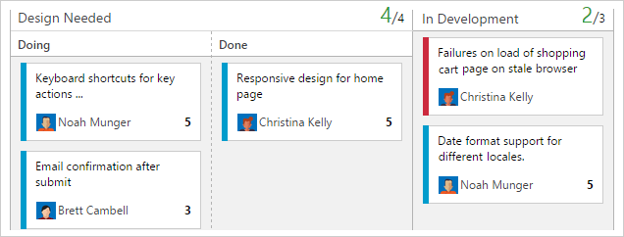
2. Kanban
Notes:
Describe the customized Kanban board as a way to visualize your product backlog and sprint work
Customized columns
WIP Limits
Split Columns
Add an item
Holding an effective standup on the sprint backlog

Slide 9
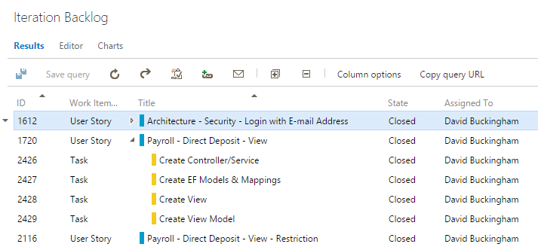





3 & 4. Querying, Charts, & Dashboards
Notes:
Lead-in – we’ve talked about requirement management, but what about the details – PMs, BAs, Developers need some details. We’ve stored and tracked a variety of information, features, epics, stories, tasks, bugs, issues, and we want to get some details.
VSO provides an extensive querying system to build dynamic queries. On top of that, once built, you can access the queries online, via excel, project, Visual studio, and even within Eclipse via TEE.
Talk about queries and how they can integrate.
Queries→Charts→Dashboards→Markdown/Welcome Page

Slide 10
Notes:
my #1 – choice of source control versioning

Slide 11
got git?

Slide 12
yes.

Slide 13

Notes:
Create a new team project.
Need to actually provide a narrative during TP provisioning
https://mikebranstein.visualstudio.com
Take-Aways: I love VSO b/c I have a choice of source control providers

Slide 14

Notes:
I’m very fortunate to be able to work with a great group of developers. And when we’re out solving mysteries, it’s important that we work as a team. Collaboration is important.
Co-location helps the team to a certain extent, but after two to three hours of ad-lib rock opera sessions, it can be a bit distracting.

Slide 15
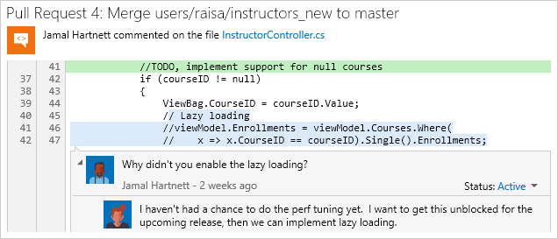
6. Meaningful Collaboration
Notes:
Highlight VSO’s Code View.
Create a comment on a source code line.
Share the changeset with a team member to get a second opinion.
What if you need to go a step further and want to fix a mistake while you’re right here? Code Editor, edit

Slide 16

Notes:
Lead-in: I don’t want to be too over-zealous, but build orchestration is truly an awesome part of VSO.
VSO provides tools to orchestrate complex builds across platforms, all accessible via the web front-end.
Script:
- walk through build steps
Talk about adding additional build steps
Queue a build
Show build progress
Talk about where the build runs (Build Agent) – TPC Build Controller
On Premise or Cloud
Introduce the project
Wrap up/take away: go build some projects – install the new build agents, try out the new build platform

Slide 17
8. REST API
Accounts and Profiles
Build
Cloud Load Test
Git
Code Policy
Project and Teams
Service Hooks
Team Rooms
Test Management
TF Version Control
Work
Work Item Tracking
http://vsointegration.azurewebsites.net
Notes:
VS project to review access the REST API.
VSO has an extensive REST API you can use to control just about everything.
- Walk through controller
Walk through view
Change view

Slide 18
9. Service Hooks
Modern Push Notifications with Subscriptions

Slide 19



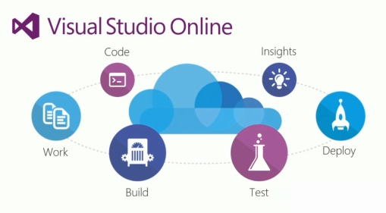


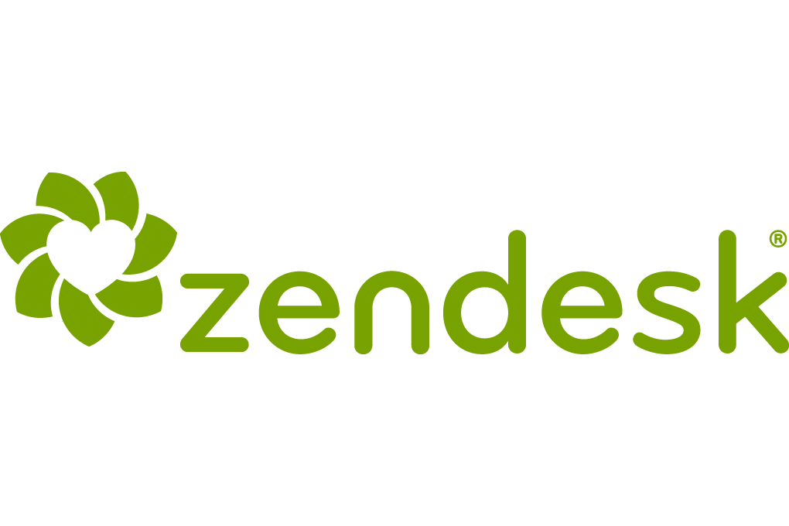






`
integrates with…
Notes:
Show Slack and then talk about custom service hooks

Slide 20
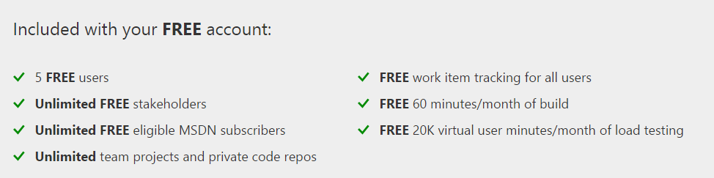
10. It’s FREE
Notes:
Licensing

Slide 21
There’s So Much More…
Release Management – Coming SOON
Teletubby video “extended mix”
Automatically Deploying and Running Integrating Coded UI Test Agents in VMs
Migrating From On-Premises TFS
Build Process Template Customization Changes
Requesting Feedback from Stakeholders
Capacity Planning
Cloud Load Tests
Notes:
What Didn’t Make the List

Slide 22
Questions?
@mikebranstein
@brosteins
brosteins.com

